Slide 1
Scribbling
Purposes of writing
Kinds of writing
Academic text
Non-academic text

Slide 2
Example
The thin line dividing fact and fiction is not often distinct in this collection of ten short stories. The central theme of each piece is what is experienced in day-to-day life and the writer brings out sharply the stark reality of social and economic injustice and inequalities.
From where? This is from a review in a news paper
Formal/semi-formal/informal: semi formal
Intended reader: general public
Reading purpose: whether the themes would interest him and whether the book is worth buying

Slide 3
Activity - discussion
Read the following texts and say if it is an Academic or non-academic text.
Say:
Where you might find it (e.g. review,blurb,etc)
Whether it is formal or informal in style
Who the intended reader (audience) is
what the reader’s purpose might be in reading this text

Slide 4
Styles of writing
Informal writing: style shows a level of familiarity and personality that sets it apart.
Colloquial, Simple, Contractions/Abbreviations, Empathy/Emotion
Formal writing: most often takes place on serious topics in a direct and succinct way
Complex , Objective , Full Words, Third Person

Slide 5
Formal
formal expressions, advanced vocabulary, longer sentences E.g. Taking everything into consideration, it can be said that the facilities offered are of poor quality.
2. formal linking words and devices (i.e. Nevertheless, Consequently, However, In addition, etc) E.g. Cell phones are extremely useful for people who travel frequently. However, they can be dangerous.
3. no use of short forms (i.e. I'm, he's been, there's ...) E.g. I would be grateful if... (Instead of: I'd be grateful if...)
4. impersonal tone (i.e. use of the passive, no description of feelings) E.g. Late this evening, 20-year-old Tom McKinley was pulled to safety after being trapped under debris for more than twenty hours.
5. factual presentation of the information E.g. The City Hall, constructed in the late 1800s, was seriously damaged by fire in 1907.

Slide 6
Informal
everyday/colloquial expressions, vocabulary and idioms
E.g. I thought I'd drop you a line..Thanks a million..., etc
frequent use of short forms E.g. I won 4 be able to come to your party as I'll be away on a business trip. 3. informal phrasal verbs
E.g. Nelly takes after her father. She's 4. simple linking words and phrases (i.e. but, so, and, because, etc) E.g. It rains a lot here, so you'd better take an umbrella with you.
5. shorter sentences E.g. Thanks a lot for the invitation. I'd love to come.
6. personal tone (the use of first person) (I/We) E.g. We've got great news. Г ve found a new job.
7. descriptive tone (use of adjectives/adverbs for vivid description) E.g. It was a bitterly cold winter evening.

Slide 7
Semi-formal
1. the use of less colloquial language E.g. Thank you very much for your letter. {Instead of: Thanks a million for your letter.) 2. less frequent use of short forms, phrasal verbs and idioms E.g. I am writing to request information about... (Instead of: I thought I'd drop you a line to ask about...) 3. a polite, respectful tone E.g. I was wondering if you had ... {Instead of: Do you have...)

Slide 8
Common academic functions
Defining
Describing
Explaining
Elaborating
Illustrating/exemplifying
Inferring
Showing cause-effect relationships
Classifying
Comparing and contrasting

Slide 9
Purposes for academic writing
Taking notes from lectures
Making notes from reference books
Writing assignments
Writing examination answers
Project reports
Seminar papers
Experiment reports

Slide 10
Read the following paragraph
The roots of India's literary traditions can be traced to the rich oral literatures of the tribes/adivasis. Usually in the form of songs or chanting, these verses are expressions of the close contact between the world of nature and the world of tribal existence. They have been orally transmitted from generation to generation and have survived for several ages.

Slide 11
Answer the questions
What is the paragraph about?
What is the central idea of the paragraph?
What are the supporting details given by the writer about the central idea?

Slide 12
Text
Central idea/ main idea – topic sentence
Supporting ideas
Paragraphing
A paragraph is a unit of text which conveys an idea with necessary explanation and suitable examples.

Slide 13
Making Connections
Grammatical linkers
Sequence linkers
Reason/ cause connectors
Rhetorical devices

Slide 14
Example 1
The students are asked to think about their lives and the people they know or have known. They should find at least two people who have influenced their lives. They may be their parents, other relatives, friends or personalities from history or literature. They should note down some points in order to be able to tell the rest of the class briefly how these people have influenced them.

Slide 15
Identify the grammatical linkers
Sahid is Rashid's half brother. They had seen each other when Rashid had visited their ancestral village when he was four years old. After Partition, their father had gone to Pakistan and settled there with his second wife. Sahid had lost his mother when he was three and remained with his paternal grandfather who had been in the Army.

Slide 16
Sahid is Rashid's half brother. They had seen each other when Rashid had visited their ancestral village when he was four years old. After Partition, their father had gone to Pakistan and settled there with his second wife. Sahid had lost his mother when he was three and remained with his paternal grandfather who had been in the Army.

Slide 17
Rewrite the sentences as a unified paragraph
Mr Lewis is my neighbour.
Mr Lewis was having a party last night.
Mr Lewis is rich and throws parties quite often.
Mr Lewis and I have been neighbours for two years.
This was the first time Mr Lewis had invited me.
It was eight o’clock.
I could see a few people through the window
I could not hear what the people were saying.
The people seemed to be enjoying themselves.

Slide 18
My , who
Although
he
At
But, they
They, themselves

Slide 19
Sequence linkers:
1. order indicators
ex. First/firstly, second/secondly ,finally
first, next, finally/ in conclusion
2. time sequence indicators
ex. When, then, presently, etc.

Slide 20
Example
In the case of colour terminology, too there may be three factors at work. First, there are some objective features – the green of living plants, the red of blood, the blue of the sky. Secondly, it may be that there is some psychological reality to the foci. Thirdly, cultural considerations may make certain colour distinctions important.

Slide 21
Insert sequence linkers
Dr Rao made Cyril wash his hands and dry them. He gave him some kind of a spoon and a small container, both rinsed in a disinfectant. With the help of his thick diary, he showed Cyril two nests to which they could transfer the black robin’s eggs.

Slide 22
First
Next
finally

Slide 23
Reason/Cause-Effect/Result connectors:
ex: because, therefore
Inferential comprehension
Ex: Much of this development he may have owned to his studious life in Paris, where he had become acquainted with ethical systems popular at that time.

Slide 24
Rhetorical device:
A set of successive statements carry connections by themselves
aided by
the force of the speaker’s intent of communication

Slide 25
How is coherence achieved?
I wish you to pay attention to what I am going to say to you. The colts who live here are very good colts, but they are cart-horse colts and of course they have not learned manners. You have been well-bred and well-born; your father has a great name in these Parts, and your grand father won the cup two years at the New market races; your grand mother had the sweetest temper of any horse I ever knew, and I think you have never seen me kick or bite. I hope you will grow up gentle and good, and never learn bad ways; do your work with a good will, lift your feet up well when you trot, and never bite or kick even in play.

Slide 26
The coherence is achieved not through explicit linkers like the time sequence linkers or the order sequence linkers but through rhetorical devices:
1. statements connect themselves
2. intention of the speaker and the force
with which he speaks

Slide 27
Arrange the following in a sequence
A light was left burning on the table, and supper was spread. 1
His mother was gone to bed.2
Yeobright walked once or twice across the room, and then suddenly went out of the house.3
Without stopping for any food he secured the doors and went upstairs.4
His mother parted her lips to begin some other vehement truth, but on looking at him saw that in his face which led her to leave the words unsaid.5
It was eleven o’clock when he came in , though he had not been further than the precincts of the garden.6

Slide 28
Answer
5
3
6
2
1
4

Slide 29
His mother parted her lips to begin some other vehement truth, but on looking at him saw that in his face which led her to leave the words unsaid. Yeobright walked once or twice across the room, and then suddenly went out of the house. It was eleven o’clock when he came in , though he had not been further than the precincts of the garden. His mother was gone to bed. A light was left burning on the table, and supper was spread. Without stopping for any food he secured the doors and went upstairs.

Slide 30
Mind Mapping
When you want to write about a particular term or a concept or an object, your mind is set to thinking. It acts as a stimulus. Keep adding relevant words so as to make the central idea concrete. These words can be further developed into ideas which can be brought together as a description of the word or concept. This is mind mapping.

Slide 31
Mind mapping

Slide 32
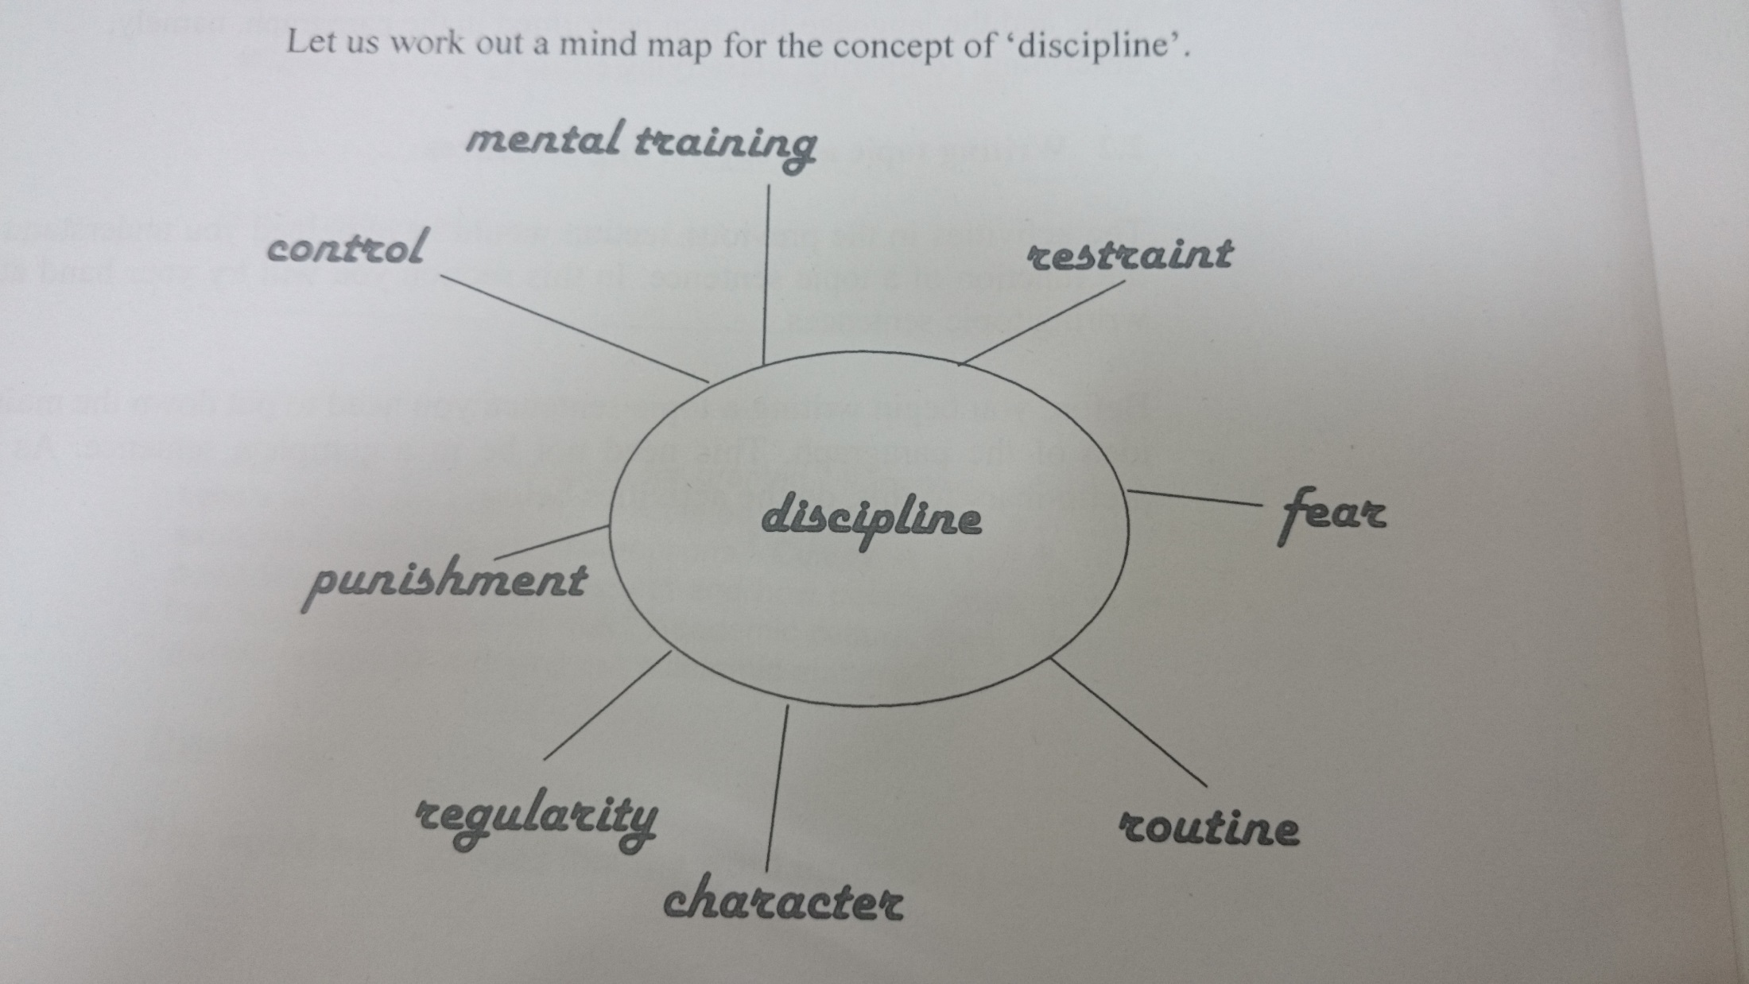

Slide 33
Paragraph writing
Now with the information in hand you can write a concrete paragraph with the help of the linkers.
The flow of ideas is smooth and you are more organised. There tends to be a logical sequence and every sentence makes sense.
The supporting sentences give strength to the main idea and how you conceive and perceive about the main idea in question.

